Slide 1



CLOUD COMPUTING
Souvik
Avinash

Slide 2

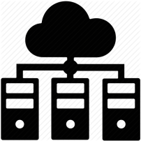
What is cloud?
The cloud is a term referring to accessing computer, information technology (IT), and software applications through a network connection, often by accessing data centers using wide area networking (WAN) or Internet connectivity
WHAT IS CLOUD COMPUTING?
Cloud computing means on demand delivery of IT resources via the internet with pay-as-you-go pricing. It provides a solution of IT infrastructure in low cost.

Slide 3
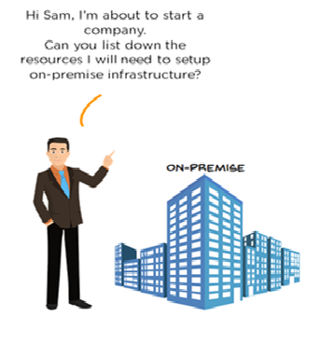

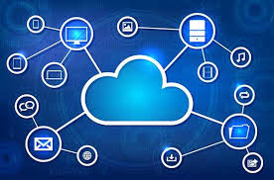
WHY Cloud computing?

Slide 4
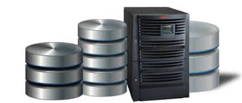
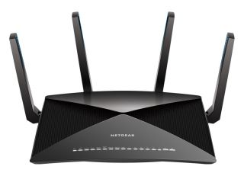
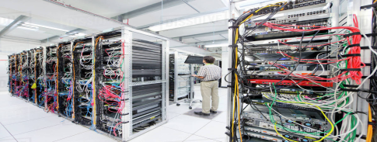
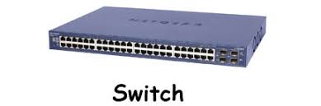
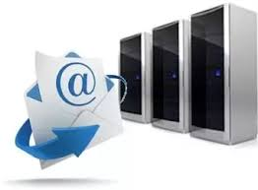
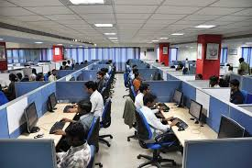
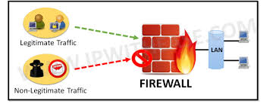
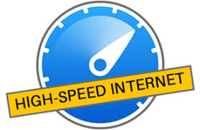
Every IT company needs :
Server Room
Database Server
Routers
Mail Servers
Firewalls
IT Engineers

Slide 5

That’s Expensive

Slide 6
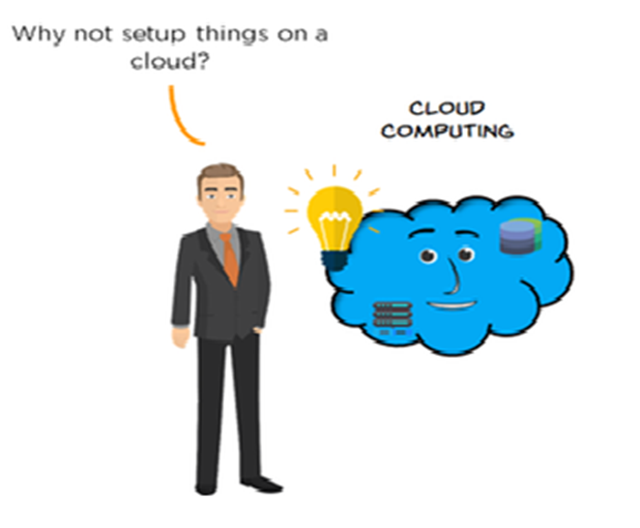


Slide 7
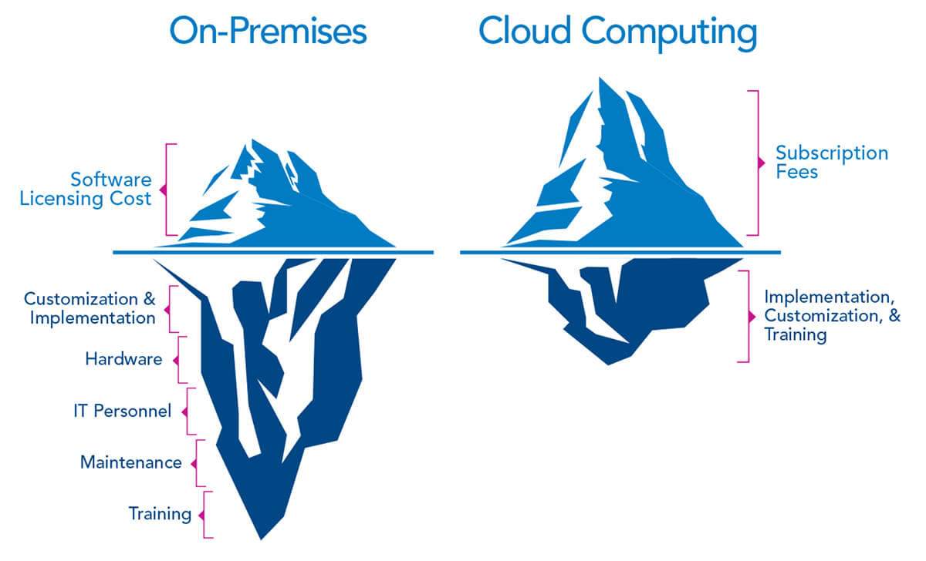
CLOUD COMPUTING - A Better option

Slide 8
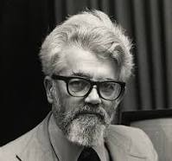
History of cloud computing
Before the cloud computing emerged, there was Client/Server computing which is basically a centralized storage in which all the software applications, all the data and all the controls resided on the server side.
If a single user wants to access specific data or run a program, he/she need to connect to the server and then gain appropriate access, and then he/she can do his/her business.
Then after, distributed computing came into picture, where all the computers are networked together and share their resources when needed.
On the basis of above computing, emerged cloud computing concepts that was later implemented.
At around in 1961, John MacCharty suggested in a speech at MIT that
computing can be sold like a utility, just like a water or electricity.
It was a brilliant idea, but like all brilliant ideas, it was ahead if its time, as
for the next few decades, despite interest in the model, the technology
simply was not ready for it.

Slide 9
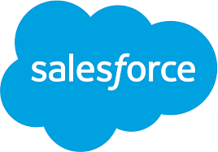
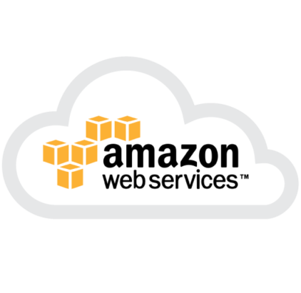
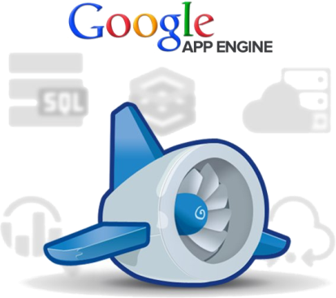
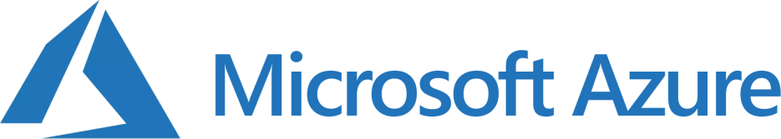
History of cloud computing
In 1999, Salesforce.com started delivering of applications to users using a simple website. The applications were delivered to enterprises over the Internet, and this way the dream of computing sold as utility were true.
In 2002, Amazon started Amazon Web Services, providing services like storage, computation and even human intelligence. However, only starting with the launch of the Elastic Compute Cloud in 2006 a truly commercial service open to everybody existed.
In 2009, Google Apps also started to provide cloud computing enterprise applications.
Of course, all the big players are present in the cloud computing evolution, some were earlier, some were later. In 2009, Microsoftlaunched Windows Azure, and companies like Oracle and HP have all joined the game. This proves that today, cloud computing has become mainstream.

Slide 10
Benefits of cloud computing
Scalable & Flexible : “on-demand" provisioning of resources on a large scale, without having engineers for peak loads.
Cost: will be reduced because to take the services of cloud computing, IT company need not to set its own infrastructure and pay-as-per usage of resources.
Maintenance of cloud computing applications is easier, since they do not need to be installed on each user's computer and can be accessed from different places. So, it reduces the cost also.
Application Programming Interfaces (APIs) are provided to the users so that they can access services on the cloud by using these APIs and pay the charges as per the usage of services.
Cloud computing enables the users to access systems using a web browser regardless of their location or what device they use e.g. PC, mobile phone etc. As infrastructure is off-site (typically provided by a third-party) and accessed via the Internet, users can connect from anywhere.

Slide 11

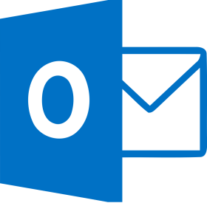
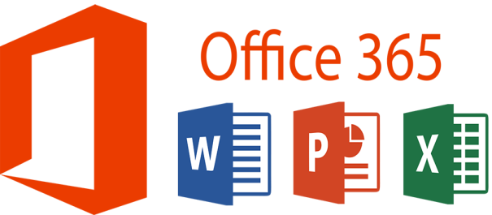
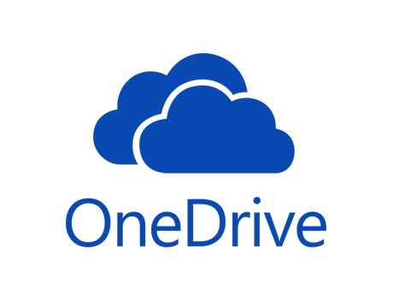
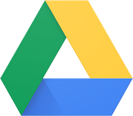
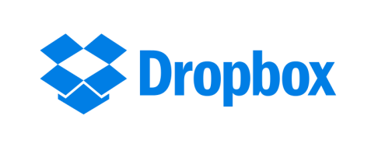
Examples of cloud computing

Slide 12
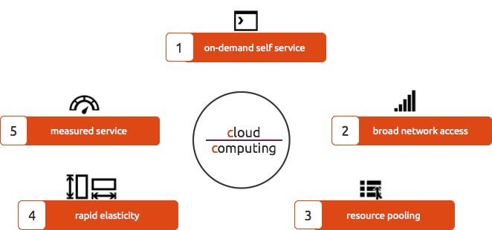
Characteristics of cloud computing

Slide 13
How Cloud Computing works ?
Assume that you are an executive at a very big corporation
Your particular responsibilities include :
Making sure that all of your employees have the right hardware and software they need.
to do their jobs.
To purchase software as well as software licenses and then provide these softwares to your employees as they require.
Whenever a new employee is hired you need to buy more software or make sure your current software license allows another user.
It is so stressful that you have to spend lots of money.
What is the Alternative ?
Instead of installing a suite of software for each computer, you just need to load one application.
That application will allow the employees to log-in into a Web-based service which hosts all the programs for the user that is required for his/her job.
Remote servers owned by another company and that will run everything from e-mail to word processing to complex data analysis programs.
It is called cloud computing, and it could change the entire computer industry.

Slide 14
How Cloud Computing works ?
Local computers have no longer to do all the heavy lifting when it comes to run applications.
Cloud computing can handle that much heavy load easily and automatically.
Hardware and software demands on the user's side decrease.
The only thing the user's computer requires to be able to run is the cloud computing interface software of the system, which can be as simple as a Web browser and the cloud's network takes care of the rest.

Slide 15
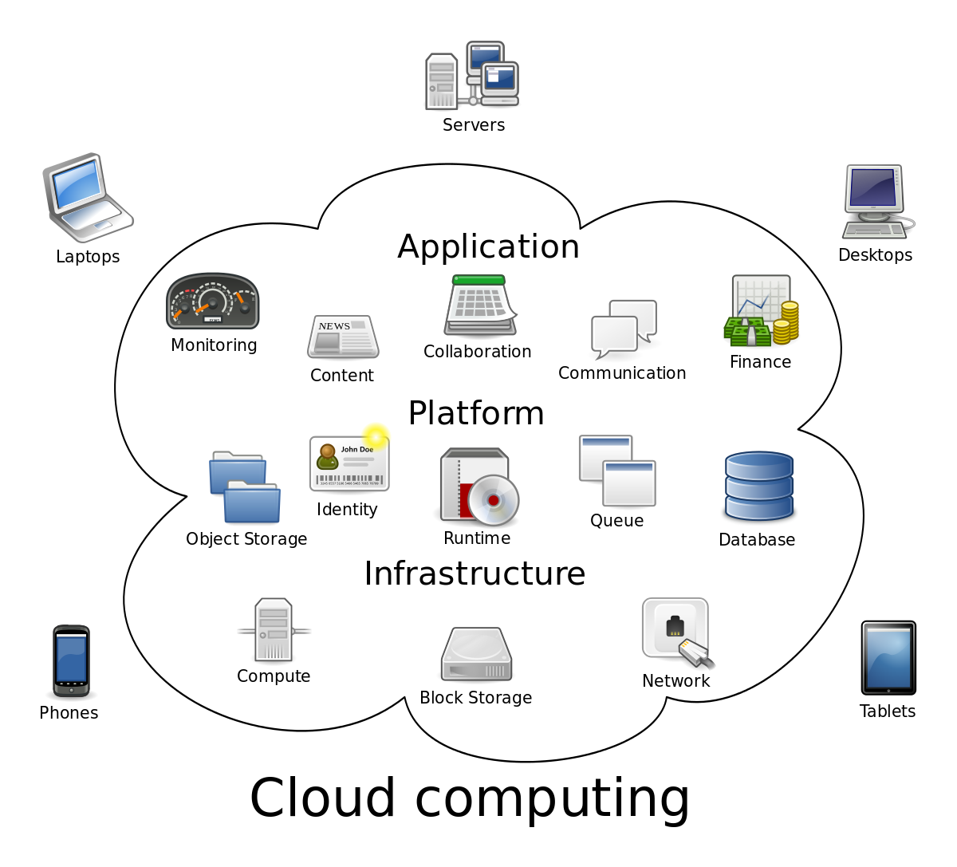
Architecture of cloud computing

Slide 16
Cloud computing models

Slide 17
Deployment models

Slide 18
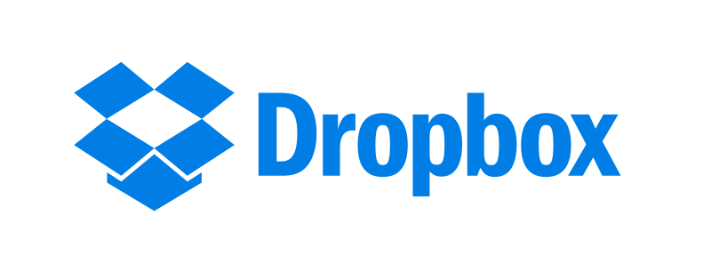

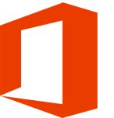
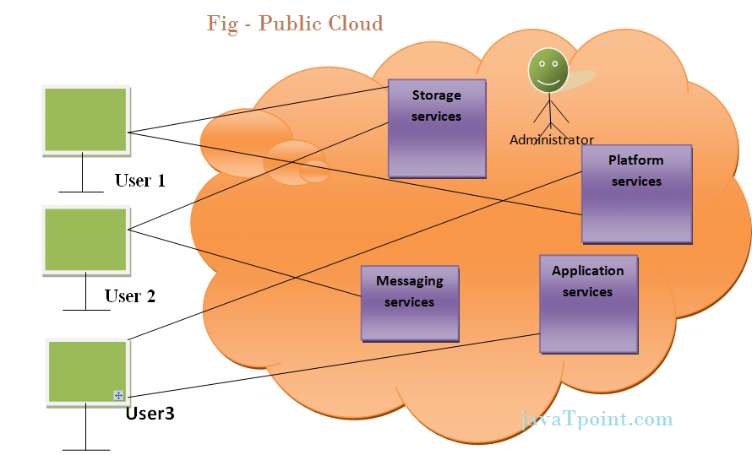
Public cloud
Public cloud allows the accessibility of systems and services easily to general public. Example: Amazon, IBM, Microsoft, Google, Rackspace etc.
Advantages of Public Cloud Model
Public cloud is having low cost as compared to private or hybrid cloud, because it shares same resources with large number of consumer.
It ensures the independency of location,
because public cloud services are delivered through Internet.
High Scalability
Disadvantages of Public Cloud Model
Low Security
In public cloud model, data is present off-site and resources are shared publicly. Hence it does not ensure the high level security.

Slide 19
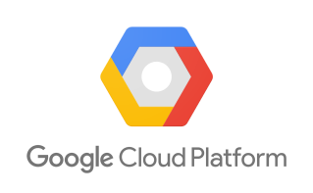
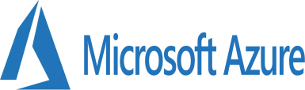
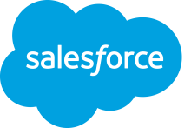
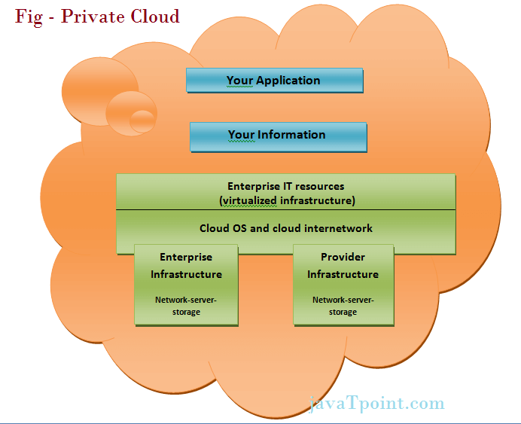
Private cloud
The Private cloud allows the accessibility of systems and services within the organization. Private cloud is operated only within a particular organization. But it will be managed internally or by third party.
Advantages of Private Cloud Model
Private cloud resources are shared from distinct pool of resources and hence highly secured.
Private clouds have more control on its resources and hardware than public cloud because it is accessed only within the boundary of an organization.
Disadvantages of Private Cloud Model
Private cloud is only accessible locally and it is very difficult to deploy globally.
Cloud is having more cost than public clouds.
Less Scalability
Private clouds are scaled only within capacity of internal hosted resources , so low scalibility.

Slide 20
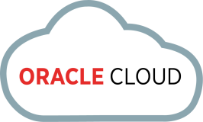



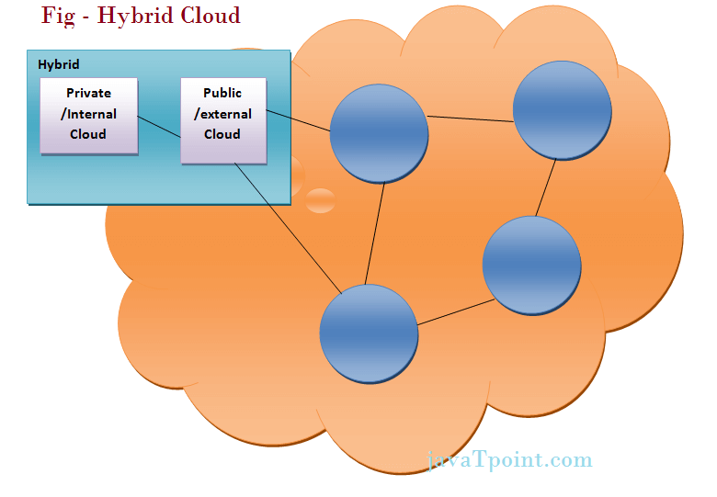
Hybrid cloud
The Hybrid cloud is the mixture of public and private cloud. Non-critical activities are performed by public cloud while critical activities are performed by private cloud.
Advantages of Hybrid Cloud Model
It provides both the features of public and private cloud scalability.
It provides secure resources because of private cloud and scalable resources because of public cloud.
It is having less cost as compared to private cloud.
Disadvantages of Hybrid Cloud Model
Networking becomes complex because of private and public cloud

Slide 21
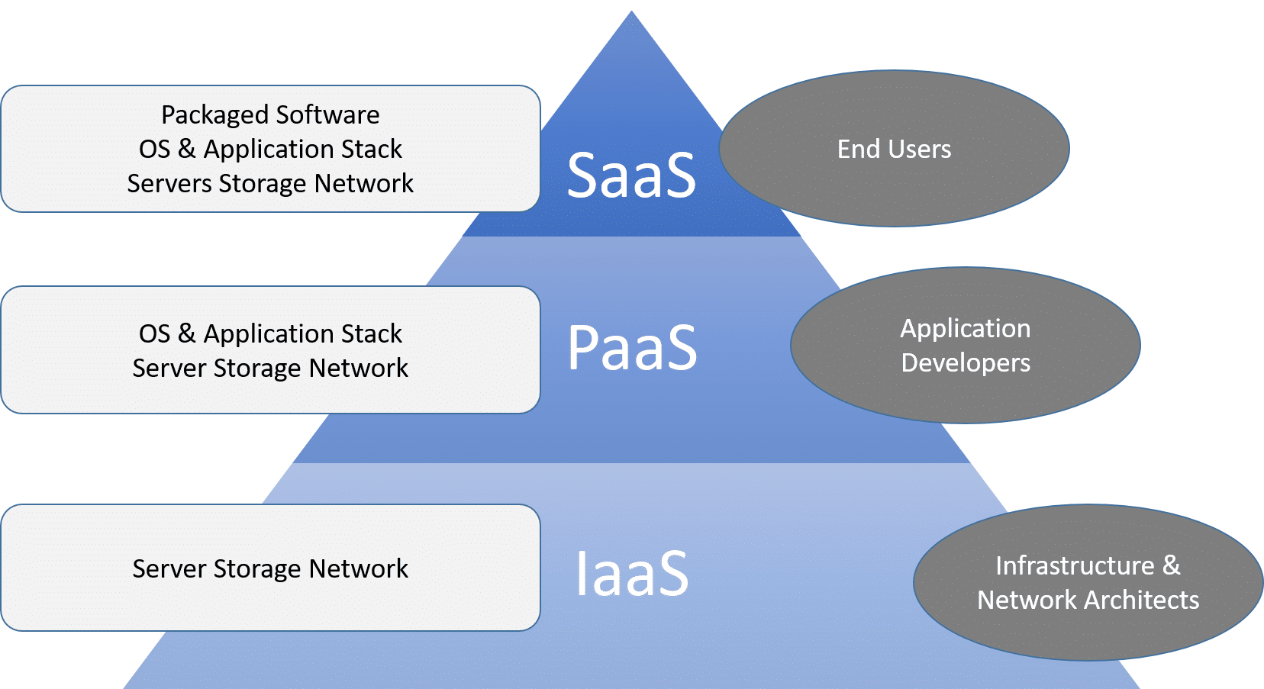
Service models

Slide 22

Iaas (infrastructure as a service)
IaaS is one of the layers of cloud computing platform wherein the customer organization outsources its IT infrastructure such as servers, networking, processing, storage, virtual machines and other resources. Customers access these resources over internet i.e. cloud computing platform, on a pay-per-use model. Iaas, earlier called Hardware as a Service (HaaS), is a cloud computing platform based model.
Advantages of IaaS cloud computing layer
Disadvantages of IaaS cloud computing layer
You can dynamically choose a CPU, memory and storage configuration as per your needs.
You easily access the vast computing power available on IaaS cloud platform.
You can eliminate the need of investment in rarely used IT hardware.
IT infra will be handled by the IaaS cloud computing platform vendors.
There is a risk of IaaS cloud computing platform vendor by gaining the access to the organization?s data. But it can be avoided by opting for private cloud.
IaaS cloud computing platform model is dependent on internet availability.
It is also dependent on the availability of virtualization services.
IaaS cloud computing platform can limit the user privacy and customization options.

Slide 23
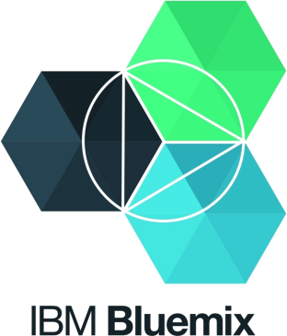
paas (platform as a service)
PaaS cloud computing platform is a developer programming platform which is created for the programmer to develop, test, run and manage the applications.
A developer is able to write the application as well as deploy it directly into this layer easily.
Advantages of PaaS cloud computing layer
Disadvantages of PaaS cloud computing layer
Developers can focus on development and innovation
without worrying about the infrastructure.
Integration with the rest of the systems applications
It may happen that some applications are local and some are in
cloud. So there will be chances of increased complexity when we
want to use data which in the cloud with the local data.
No requirements of up-front investment in hardware
and software. Developers only need a PC and an internet
connection to start building applications.
Data Privacy
Corporate data, whether it can be critical or not, will be private so
if it is not located within the walls of the company there can be a
risk in terms of privacy of data.
Prebuilt business functionality
Some PaaS vendors also provide already defined business
functionality so that users can avoid building everything from
very scratch and hence can directly start the projects only.

Slide 24

Saas (software as a service)
SaaS is a software distribution model in which applications are hosted by a cloud service provider and made available to customers over internet. SaaS is also known as "On-Demand Software".
Advantages of SaaS cloud computing layer
Disadvantages of SaaS cloud computing layer
SaaS is easy to buy
Actually data is stored in cloud, so security may be an issue for some users
SaaS pricing is based on a monthly fee or annual fee, SaaS
allows organizations to access business functionality at a
low cost which is less than licensed applications.
Since the data and application are stored in cloud at a variable distance from the end user, so there is a possibility that there may be more latency while interacting with the application than a local deployment. So, SaaS model is not suitable for applications whose demand response times are in milliseconds.
Less hardware required for SaaS
The software is hosted remotely, so organizations
don't need to
invest in additional hardware.
Total Dependency on Internet
Without internet connection, most SaaS applications are not
usable.
Low Maintenance required for SaaS

Slide 25
Pros and cons
Lower cost computer for users
Require a constant Internet Connection
Cloud computing is impossible without Internet connection.
To access any applications and documents you need a constant
Internet connection.
Require High Speed Internet connection
Stored Data Might Not Be Secure
With cloud computing, all your data is stored in the cloud.
That's all well and good, but how secure is the cloud?
Can't unauthorized users gain access to your confidential data?
Lower IT infrastructure cost
Fewer maintenance cost
Lower Software Cost
Instant software updates
Similarly, a low-speed Internet connection makes cloud computing painful at best and often impossible. Web based apps often require a lot of bandwidth to download, as need to download large documents.
Increased computing Power
Unlimited storage capacity

Slide 26

Thank’s for your valuable time and attention ☺

